Slide 1
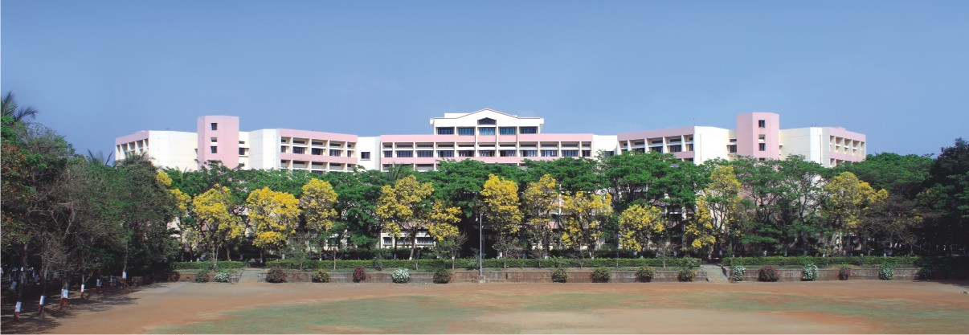

Seminar Topic
Presented by: PID-4
Class : TY-A
Guided by :Prof. Monali Mahajan
Notes:
NOTE:
To change the image on this slide, select the picture and delete it. Then click the Pictures icon in the placeholder to insert your own image.

Slide 2

Outline
Introduction
Problem Statement
Objectives
Literature Review
Methodology(Block diagram,Proposed approach,Techniques,tools)
Expected Outcomes (Input,Output)
Summary (Key takeaways from seminar)
References(List of papers and sources referred)

Slide 3
Introduction
Modern manufacturing industries are rapidly adopting digital technologies to improve efficiency, safety, and operational management. However, many small and medium scale industries still rely on manual processes and disconnected systems for monitoring machinery, managing inventory, tracking production, and ensuring worker safety. This lack of integration often leads to production delays, inefficient resource utilization, machine downtime, and increased risk of workplace accidents. Additionally, traditional surveillance systems such as CCTV cameras only record activities but do not actively analyze incidents or provide intelligent alerts and generate report.
The AI Based Integrated Industrial Monitoring and Management System is designed to address these challenges by providing a centralized platform that integrates machinery monitoring, inventory management, client order systems, and department wise performance analysis. The system also incorporates image processing for incident detection and IoT based proximity sensors to improve workplace safety and prevent accidents near machines. By providing real time monitoring and performance analytics through a centralized dashboard, the system helps industries improve productivity, safety, and decision making while supporting the transition toward smart manufacturing environments.

Slide 4
Problem Statement
Title - AI-Based Integrated Industrial Monitoring and Management System
Manufacturing industries face significant challenges in managing multiple operational activities such as machinery monitoring, inventory control, worker safety, client orders, and coordination between departments. In many small and medium scale factories these processes are handled manually or through separate systems, which results in lack of real time visibility, inefficient communication, and delayed decision making. Machine failures, inventory shortages, and safety hazards are often detected late, causing production delays and financial losses. Traditional CCTV surveillance systems only record video footage but do not automatically detect incidents or unsafe worker behavior. Additionally, management teams often lack proper tools to analyze department wise performance and machine utilization effectively. Without an integrated monitoring system, it becomes difficult to ensure safety, optimize production, and maintain efficient communication between clients and factory departments. Therefore, there is a need for a centralized intelligent platform that integrates machinery monitoring, inventory management, performance analysis, client interaction, and safety monitoring using image processing and IoT based sensors to improve industrial efficiency and workplace safety.

Slide 5
Objectives
To design and develop an AI Based Integrated Industrial Monitoring and Management System for smart factory operations.
To monitor machinery performance and utilization in real time to reduce downtime.
To implement an inventory management system for tracking raw materials and stock levels efficiently.
To develop a client system that connects customers with the production process and order management.
To analyze department wise and worker performance using a centralized analytics dashboard.
To enhance industrial security using image processing for incident detection and reporting.
To integrate IoT based proximity sensors for safety monitoring and accident prevention near machines.
To improve coordination between departments such as production inventory HR and management.

Slide 6
Literature Review
• Security and Safety Monitoring: AI based computer vision systems analyze CCTV footage to detect unsafe worker behavior and restricted area entry, improving industrial safety and incident detection.
• Machinery Monitoring: IoT sensors and predictive maintenance techniques monitor machine parameters such as vibration and temperature to detect faults and reduce unexpected machine failures.
• Performance Analysis: Smart manufacturing systems use real time data analytics to evaluate machine utilization, production efficiency, and worker productivity for better decision making.
• Inventory Management: Digital inventory management systems track raw materials and stock levels in real time and generate alerts to prevent shortages and production delays.
• IoT Based Safety Systems: Proximity sensors and IoT devices are used near industrial machines to detect unsafe human proximity and trigger alerts to prevent workplace accidents.

Slide 7
Methodology of Performance Analysis
In performance analysis, our objective is to evaluate machine utilization, production efficiency, and worker productivity for better decision-making.
Methodology begins with data collection from industrial sources such as training records, machine checkpoints, and 5S audit reports.
The collected data is preprocessed by cleaning, handling missing values, and normalization.
Next, we transform this data into Key Performance Indicators, or KPIs, for worker (Efficiency = Output / Time) , machine (Utilization = Operating Time / Total Available Time) , and company-level analysis(Training Completion Rate = Completed Trainings / Total Trainings).
After reading multiple Research paper my approach for performance analysis is we apply machine learning models such as Decision Tree for classification, Linear Regression for prediction, and Random Forest for improved accuracy.

Slide 8
Worker Performance
We calculate KPIs such as:
Efficiency = Work Done / Time Taken
Training Score = Completed Trainings / Total Trainings
Skill Index = Sum of Skill Levels / Number of Skills
We then apply Decision Tree classification: Decision Tree splits data based on features like skill level and training score to classify workers into low, medium, and high performance.
We also use Linear Regression for prediction: y = β₀ + β₁x₁ + β₂x₂ + … + βₙxₙ where y is predicted performance and x represents features like training score and efficiency.

Slide 9
Machine Performance
We calculate KPIs such as:
Machine Utilization = Operating Time / Total Time
Failure Rate = Number of Failures / Total Operations
Downtime = Total Time – Operating Time
We apply Random Forest algorithm, which is an ensemble of multiple Decision Trees: Prediction = Average of all tree outputs
We also use Regression models to predict machine failure: Failure Prediction = f (usage, condition, maintenance data)

Slide 10
Company Performance
For company-level performance analysis, we use data such as 5S audits, zone-wise scorecards, and dashboard metrics including quality, safety, and dispatch.
We calculate Key Performance Indicators such as:
5S Score = (Sum of Audit Scores / Total Score) × 100
Overall Efficiency = Total Output / Total Input
Performance Index = w₁x₁ + w₂x₂ + w₃x₃
where x₁, x₂, x₃ represent KPIs such as quality, safety, and efficiency, and w₁, w₂, w₃ are their respective weights.
We apply Linear Regression to analyze performance trends and predict future company performance.
This helps management identify low-performing zones and take data-driven decisions to improve overall efficiency.

Slide 11
Block Diagram of Performance Analysis

Slide 12
Expected outcome
• Development of an integrated platform for monitoring industrial operations in real time.
• Improved machinery monitoring and reduced downtime through continuous machine performance tracking.
• Better inventory management with real time stock tracking and automated alerts.
• Enhanced industrial safety using image processing for incident detection and IoT based proximity sensors.
• Efficient client and customer order management through a centralized client portal.
• Department wise performance analysis to help management monitor productivity and decision making.
• Improved coordination between production inventory HR and management through a unified dashboard.

Slide 13
Summary
The AI Based Integrated Industrial Monitoring and Management System is designed to improve efficiency, safety, and operational management in manufacturing industries by integrating multiple industrial functions into a single intelligent platform. The system focuses on monitoring machinery performance, managing inventory, analyzing department wise productivity, and connecting clients with the production system. It uses modern technologies such as Artificial Intelligence, Internet of Things, image processing, and web based enterprise management systems.
The platform provides real time monitoring of machines to track utilization and detect abnormal behavior. An inventory management module maintains raw material stock and generates alerts when stock levels fall below the required limit. The system also includes a client portal that allows customers to place orders and track production status. Department wise dashboards help management analyze performance of different departments such as production, HR, and inventory.
For safety and security, the system uses image processing to detect industrial incidents and automatically generate incident reports. IoT based proximity sensors are used near machines to detect unsafe worker proximity and prevent accidents. By integrating safety monitoring, machinery analysis, inventory control, client management, and performance analytics, the system helps industries improve productivity, safety, and decision making while supporting the transition toward smart manufacturing environments.

Slide 14
References
Module | References
Machinery Monitoring | Machine Vision Based Monitoring of Industrial Machines – https://ieeexplore.ieee.org/document/9099865
 | Predictive Maintenance Using Machine Learning for Industrial Systems – https://ieeexplore.ieee.org/document/8471327
 | Industrial Machine Health Monitoring Using IoT Sensors – https://ieeexplore.ieee.org/document/9036156
Inventory Management | IoT-Based Smart Inventory Management System for Industrial Applications – https://ieeexplore.ieee.org/document/8768208
 | Cloud-Based Inventory Control System Using IoT – https://ieeexplore.ieee.org/document/8976120
 | Smart Warehouse Management System Using Internet of Things – https://ieeexplore.ieee.org/document/9154132
Security / Safety Monitoring | Deep Learning Based Safety Helmet Detection for Worker Protection – https://ieeexplore.ieee.org/document/9003246
 | Computer Vision Based Industrial Safety Monitoring System – https://ieeexplore.ieee.org/document/9158251
 | Real-Time Accident Detection Using CCTV and Deep Learning – https://ieeexplore.ieee.org/document/9444513
Performance Analysis | Predictive Model for High Energy Consumption Processes in the Steel Manufacturing Industry Using Machine Learning Tools: Industry 4.0 Pathway – https://ieeexplore-ieee-org-kkwagh.knimbus.com/document/10776708
 | Multimodal AI-Driven Decision Support Framework for Strategic Management Optimization – https://ieeexplore-ieee-org-kkwagh.knimbus.com/document/11379426
 | A Review of Machine Learning Techniques for Predictive Maintenance in Industry 4.0 – https://ieeexplore-ieee-org-kkwagh.knimbus.com/document/10927025

Slide 15
THANK YOU !!
Name of Team: PID-4
Email : aimms.pid4@gmail.com
Department of Computer Engineering
K.K.Wagh Institute of Engineering Education & Research, Nashik

